Slide 1

Pool Regulation Changes for 2018
David Hornsby, REHS
Area Manager

Slide 2

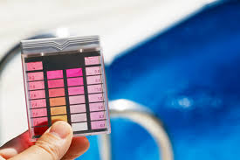
Minimum Disinfectant Levels
Minimum disinfectant levels vary due to type of pool and whether using stabilizer(cyanuric acid).

Slide 3
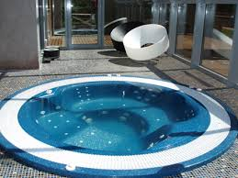
Spas
Minimum free chlorine level is 3.0 parts-per-million (ppm).
Minimum bromine level is 4.0 ppm.

Slide 4
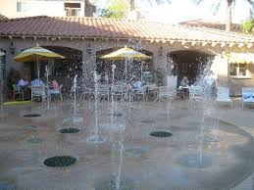
Interactive Water Play Pool
(Spray Pad)
Minimum free chlorine level is 2.0 ppm.
Minimum bromine level is 3.0 ppm.

Slide 5
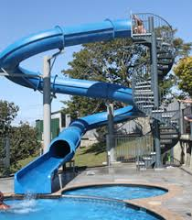
Activity Pool
This includes, but is not limited to slides, flumes, lily pad walks, log rolls, cable, rope, boom drops, and any other falling entry features.
Minimum free chlorine level is 2.0 ppm.
Minimum bromine level is 3.0 ppm.

Slide 6
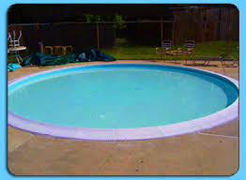
Wading Pool
Minimum free chlorine level is 2.0 ppm.
Minimum bromine level is 3.0 ppm.

Slide 7
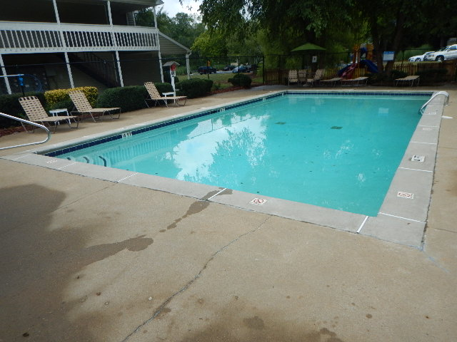
All Other Pools
Minimum free chlorine level is 1.0 ppm unless using cyanuric acid, then the minimum level is 2.0 ppm.
Minimum bromine level is 3.0 ppm.

Slide 8
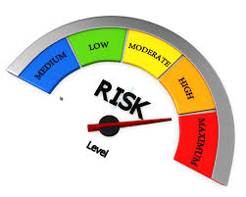
Maximum Level of Disinfection
The maximum level of free chlorine for all pools and spas is 10.0 ppm.
The maximum level of bromine for all pools and spas is 8.0 ppm.

Slide 9
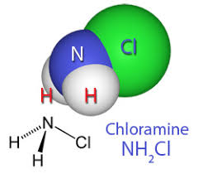
Combined Chlorine
Maximum Level
The maximum level of combined chlorine in all pools and spas is 0.4ppm.

Slide 10
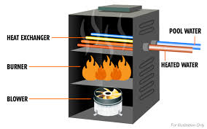
Gas Pool Heater Inspections
A third party inspection is required of gas pool heaters.

Slide 11

Pool Signage
When applicable “No Lifeguard on Duty” sign must be a minimum of 4 inch letters.
Pool signage in clear public view must include that animals, except service animals, are not allowed in the pool enclosure.
Spas must have an additional rule posted, in clear public view, to address the maximum temperature being 104 degrees Fahrenheit.

Slide 12

Main Drain Covers
All main drain covers must meet meet the federal anti-entrapment requirements.

Slide 13
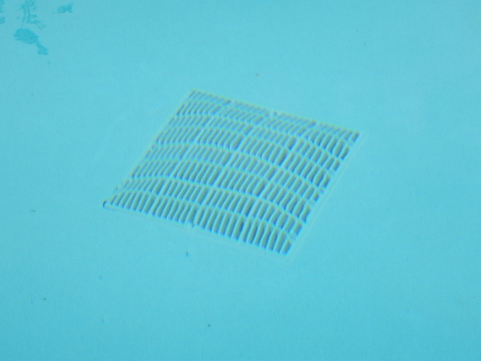
Main Drain Cover
Approved Example
All main drains must have approved covers installed.

Slide 14
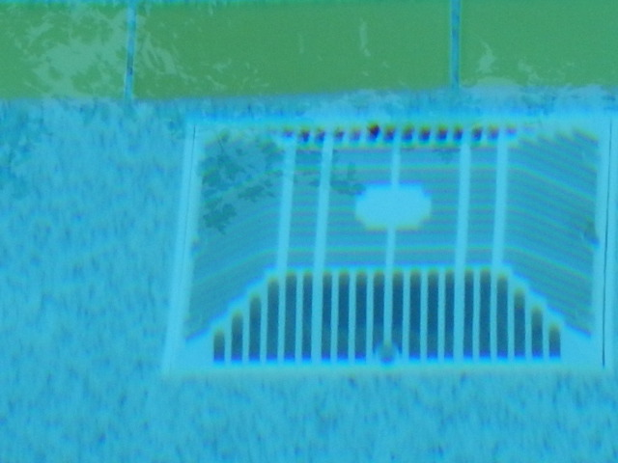
Main Drain Cover
Approved Example
Covers cannot be broken, missing or out of place.

Slide 15
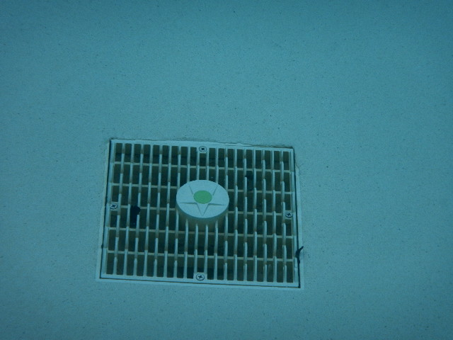
Main Drain Cover
Approved Example

Slide 16
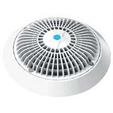
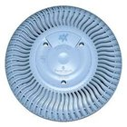
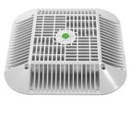
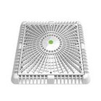
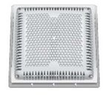
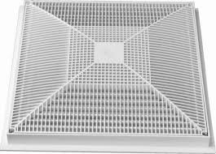
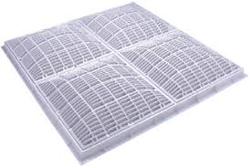
Main Drain Covers Approved
Examples

Slide 17
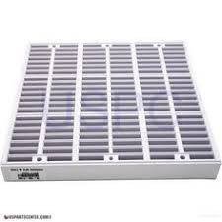
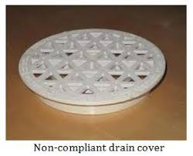
Main Drain Covers
Unapproved
Examples

Slide 18

Equalizer Suction Line Covers
All equalizer line openings into the pool must have an approved cover installed.

Slide 19
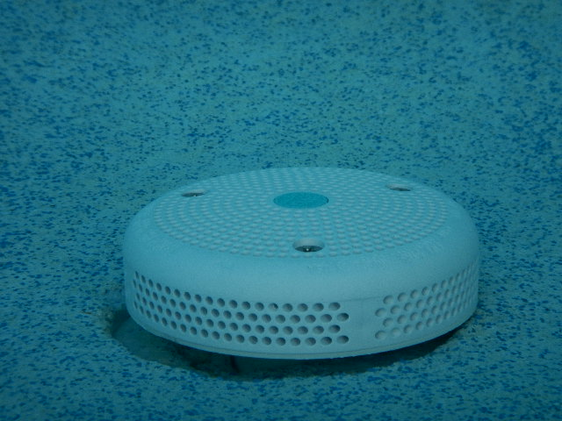
Equalizer Suction Line Covers
Approved Example

Slide 20
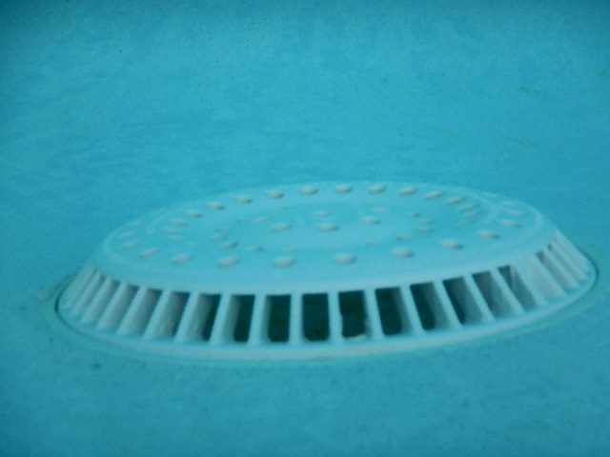
Equalizer Suction Line Covers
Approved Example

Slide 21
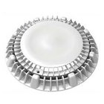
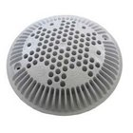
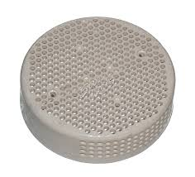
Equalizer Suction Line Covers
Approved Examples

Slide 22
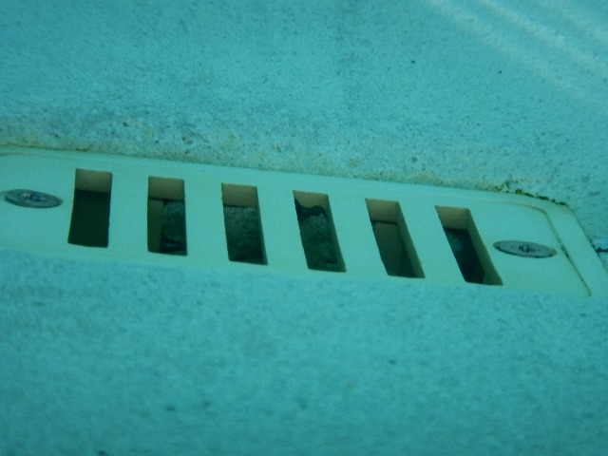
Equalizer Suction Line Covers
Unacceptable Example

Slide 23
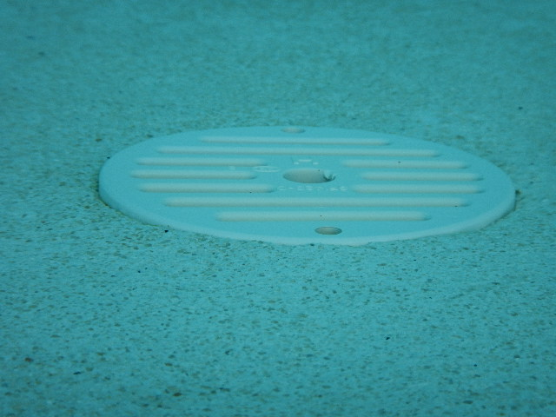
Equalizer Suction Line Covers
Unapproved Example

Slide 24
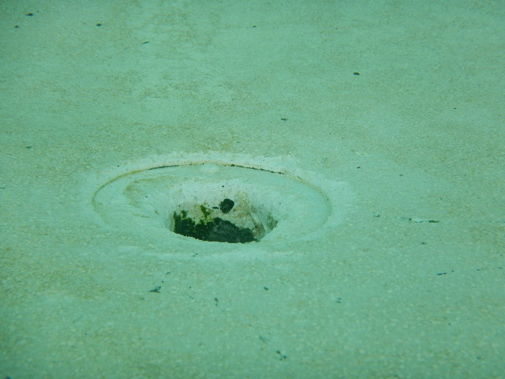
Equalizer Suction Line Covers
Unapproved Example

Slide 25
Equalizer Suction Line Covers
Disablement
An approved cover on the equalizer suction line is not needed if the equalizer line has been disabled.
Even if the equalizer line is disabled an unbroken cover must be in place to prevent entrapment.

Slide 26
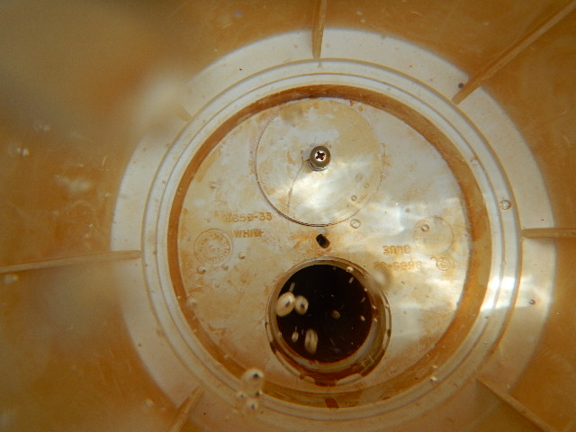
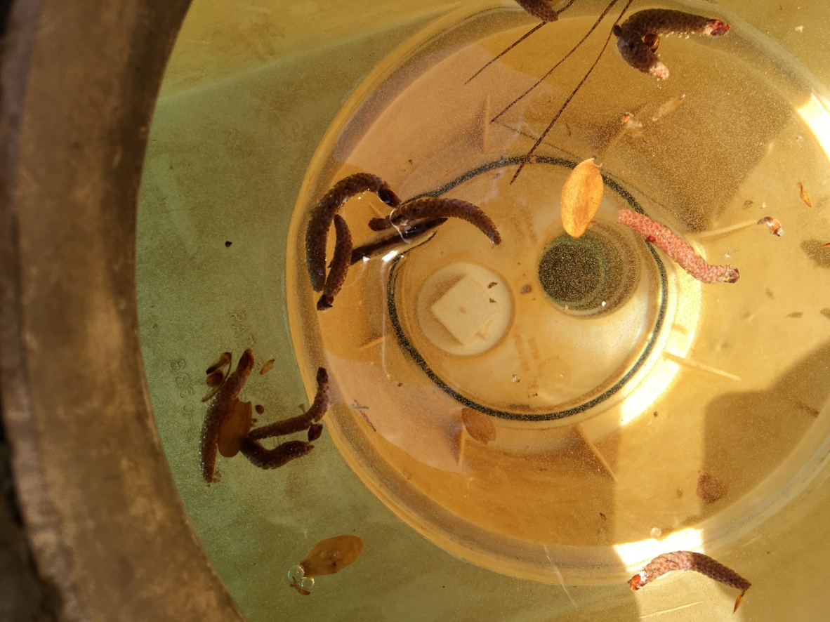
Equalizer Suction Line Covers
Disablement
Not Disabled
Disabled

Slide 27
Updated
Imminent Health Hazards
Any violation will require closure of the pool until corrected:
Suction outlet main drain covers and skimmer equalizer line covers must meet federal anti-entrapment requirements.
a. Approved covers must be installed.
b. Covers cannot be broken, missing or out of place.
Vacuum caps must be in place.

Slide 28
Updated
Imminent Health Hazards
Any violation will require closure of the pool until corrected:
3. Disinfectant levels based on pool type:
a. Spas
* 3.0 - 10.0 ppm free chlorine
* 4.0 - 8.0 ppm bromine
b. Activity / Interactive / Wading Pools/Spray Pads
* 2.0 - 10.0 ppm free chlorine
* 3.0 - 8.0 ppm bromine
c. All Other Pools
* 1.0 - 10.0 ppm free chlorine of no cyanuric acid chlorine stabilizer used.
* 2.0 - 10.0 ppm free chlorine if cyanuric acid chlorine stabilizer is used.

Slide 29
Updated
Imminent Health Hazards
Any violation will require closure of the pool until corrected:
4. pH must be maintained between 7.2 - 7.8.
5. Filtration system/disinfection system must be functioning.
6. Main drain cover must be clearly visible in the bottom of the pool.
7. No broken glass or other sharp objects in the
pool or on the pool deck.

Slide 30
Updated
Imminent Health Hazards
Any violation will require closure of the pool until corrected:
7. Approved barrier, including self-closing, self-latching gate, must be in place.
8. All water supplying pools or pool facilities must be from an approved source. Well water must be tested to make sure it is potable.
9. Any fecal or vomit incident.

Slide 31
QUESTIONS?
David Hornsby, REHS
Area Manager
770-963-5132, Ext. 514
david.hornsby@gnrhealth.com

